Slide 1
About 15 can’t miss commands in dbatools 1.0
Chrissy LeMaire
Notes:
This is the slide shown before the presentation starts. When you are ready to go, tell the video operator to start the recording, and click to the next slide.

Slide 2
about_Speaker
Automation Engineer with GDIT at NATO Special Ops HQ
PowerShell & SQL Server MVP, PowerShell Community Hero

Slide 3

This Session
Will highlight some PowerShell commands that will simplify your life
and practically do your dishes

Slide 4

Agenda
Overview of the journey to dbatools 1.0
Demos galore

Slide 5
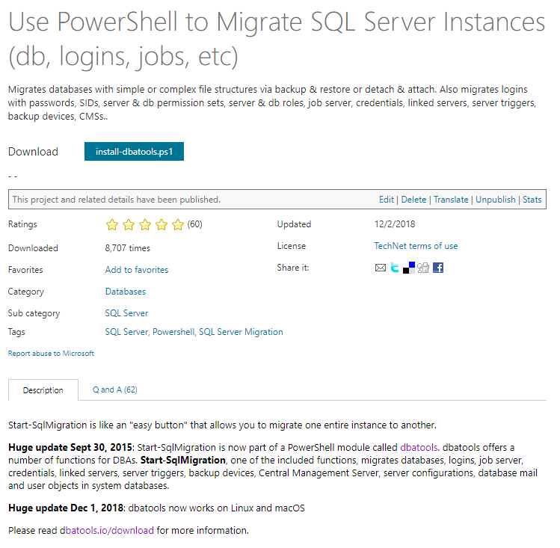
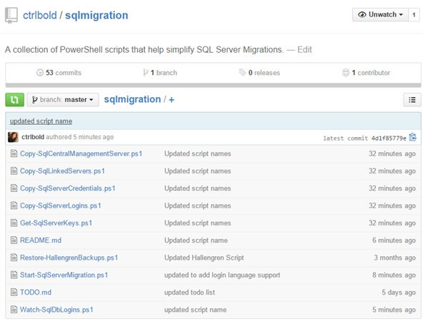
The beginning - July 2014
Start-SqlMigration.ps1 in Script Center
sqlmigration folder on GitHub

Slide 6

The module - September 2015
dbatools module in GitHub

Slide 7
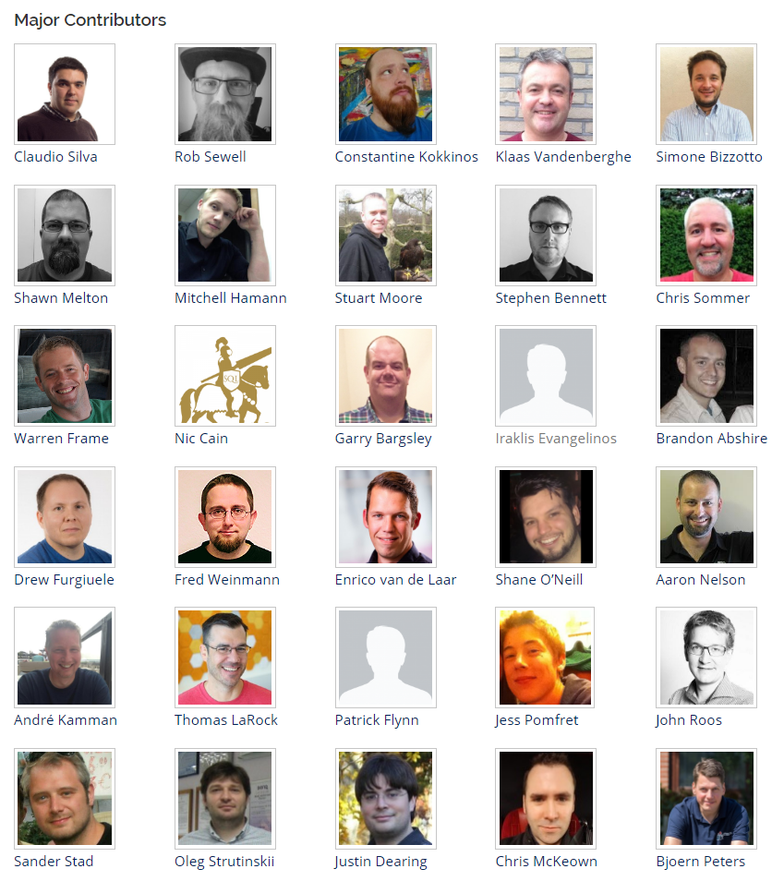




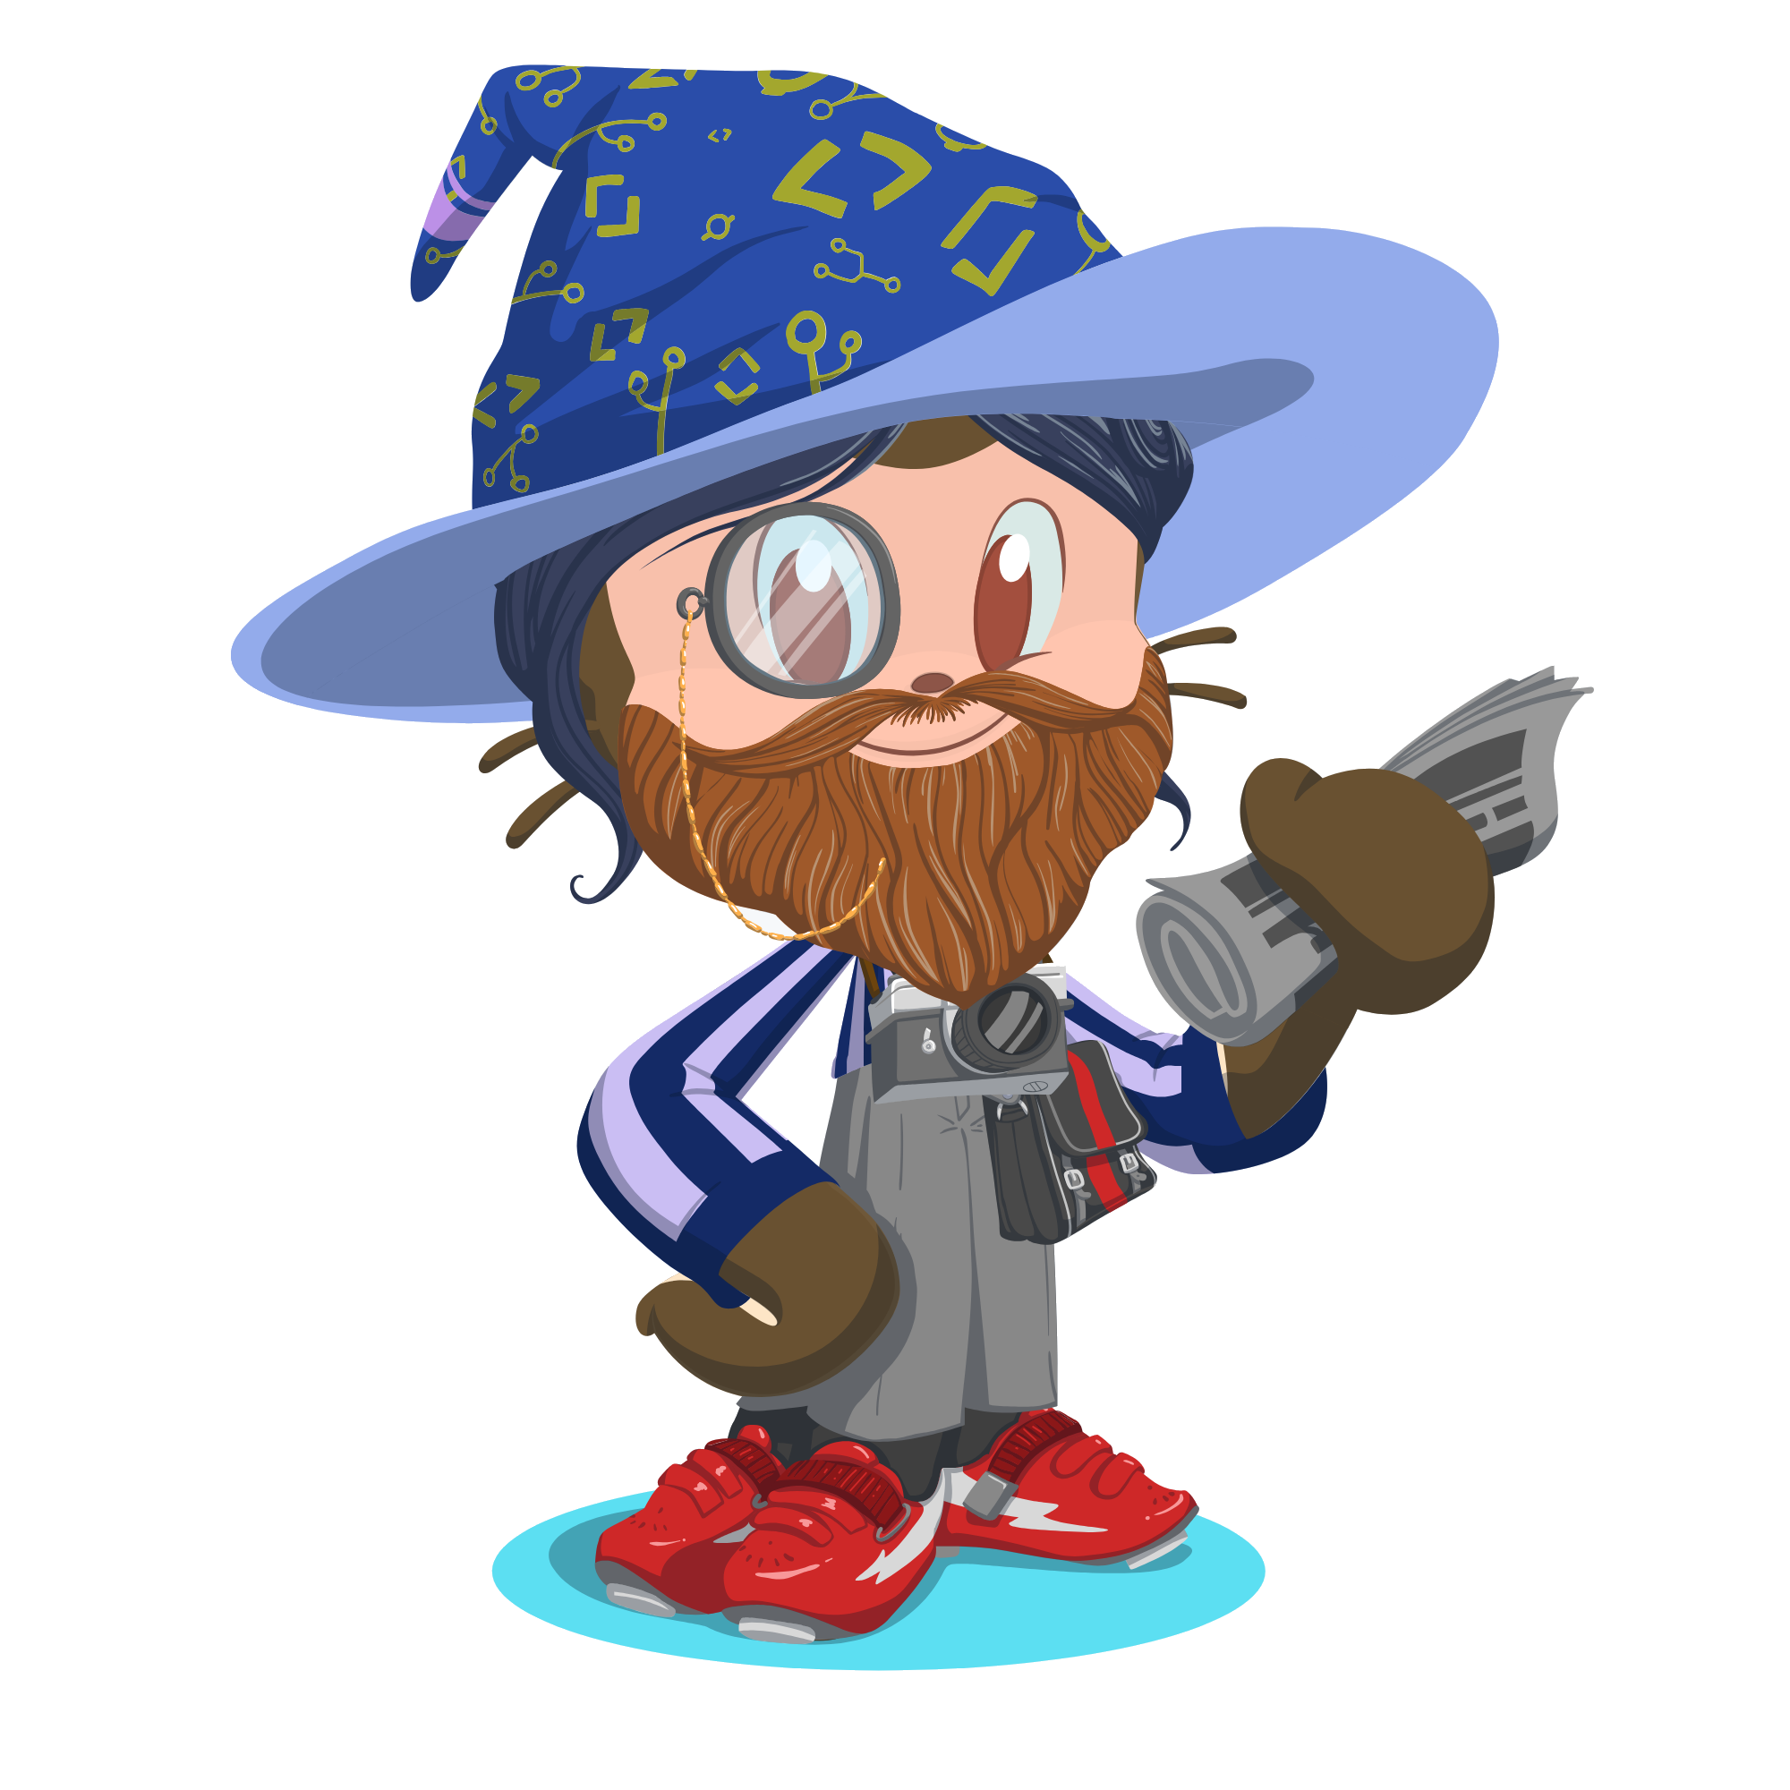
The community - June 2016
Others started joining in!

Slide 8

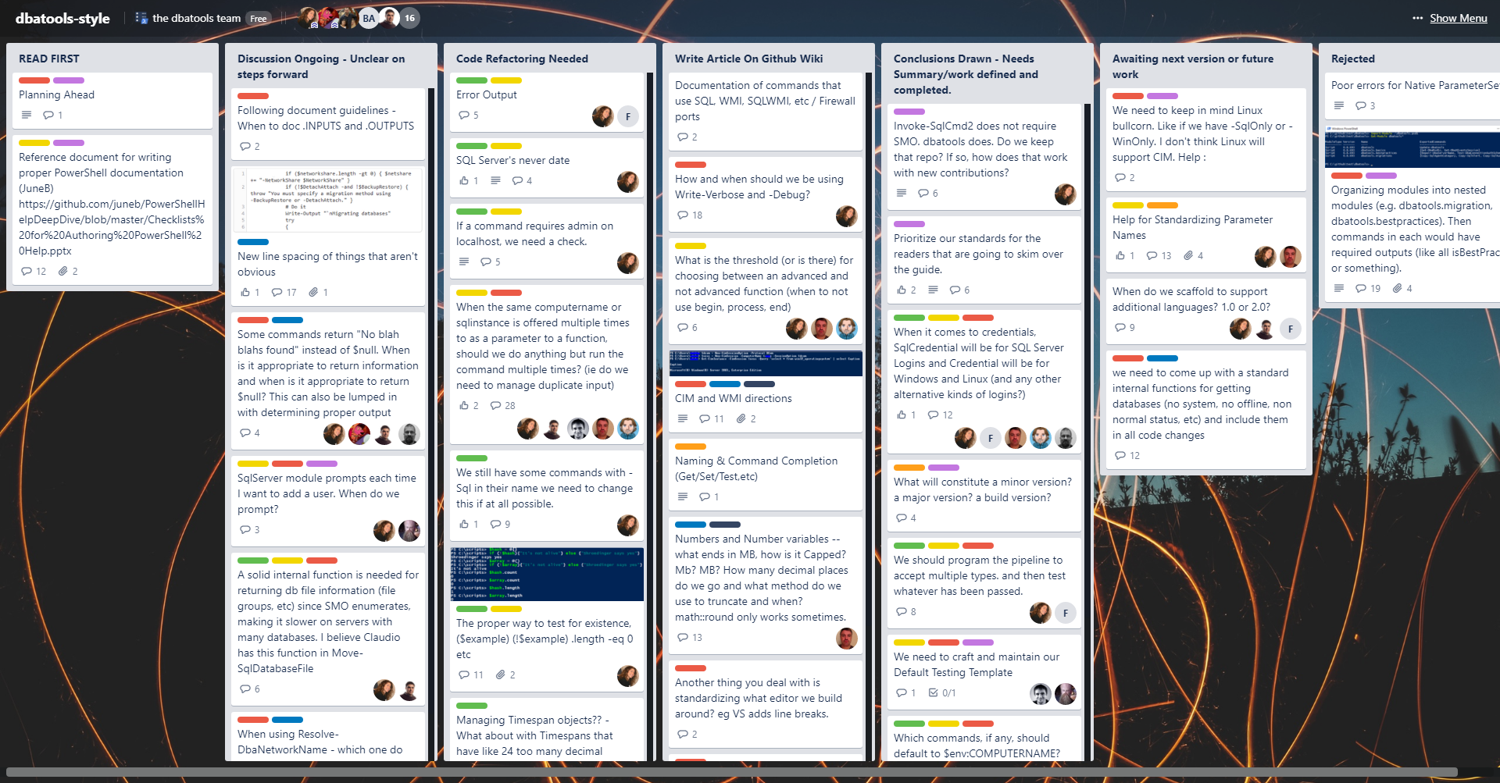
1.0 Officially Begins – January 2017

Slide 9
1.0 Officially Begins – January 2017
Standardized documentation
Standardized names for parameters, commands, etc
Standardized outputs
Added Pester tests and AppVeyor
Testing
Bug fixes
Releasing more often

Slide 10

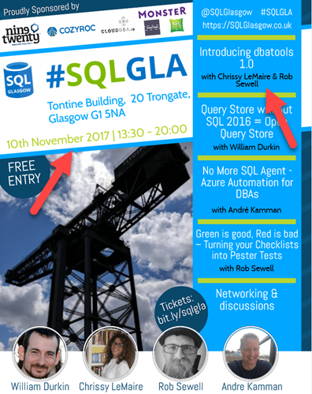
Oops - November 2017

Slide 11

Now
Prerelease branch and a date!
Over 160 contributors!
MIT!
Loads 3x faster!
Supports Azure a bit better!
Runs on PowerShell Core!
75% of commands run on Mac/Linux!
Still supports PowerShell 3, too!
Still supports SQL Server 2000, mostly!
Will have an accompanying MEAP!
Notes:
MEAP

Slide 12
Demo grouping
Classics
Fan Favorites
Must Haves
Combo Kills

Slide 13
Notes:
[REQUIRED SLIDE]
Make sure you provide all materials that audience needs to reproduce your demos.
Either upload them as a PowerShell module to www.powershellgallery.com (preferred for reusable functions)
Or, upload them to our github repository (ask the girls at the info desk to provide you with access)
Or, upload them to your own github repository
Please make sure all materials are available by the time your presentation starts, or at minimum upload them right after your presentation

Slide 14
PARTY TIME

Slide 15
Notes:
[REQUIRED SLIDE]
If you sticked to your timing, you now have 15 min left for Q&A. If you missed your timing, you will have to leave the room when your slot is over. In this case, invite your audience to the coffee break and offer to cover questions there.
IN ANY CASE please point your audience to the conference app and the session voting. By the time the conference opens, the eventraft app *should* have the option to vote on sessions.
Please MAKE SURE you leave your room when your slot is over. The next speaker would like to set him/herself up and get everything up and running.

